Slide 1
Chapter 9 Additive Models，Trees，and Related Models
The Elements of Statistical Learning

Slide 2
Introduction
In this chapter we begin our discussion of some specific methods for supervised learning
9.1: Generalized Additive Models
9.2: Tree-Based Methods
9.3:PRIM:Bump Hunting
9.4:MARS: Multivariate Adaptive Regression
Splines
9.5:HME:Hieraechical Mixture of Experts

Slide 3
9.1 Generalized Additive Models
In the regression setting, a generalized additive models has the form:
Here fj’s are unspecified smooth and nonparametric functions.
Instead of using LBE in chapter 5, we fit each function using a scatter plot smoother(e.g. a cubic smoothing spline)

Slide 4

GAM(cont.)
For two-class classification, the additive logistic regression model is:
Here

Slide 5
GAM(cont)
In general, the conditional mean U(x) of a response y is related to an additive function of the predictors via a link function g:
Examples of classical link functions are the following:
Identity: g(u)=u
Logit: g(u)=log[u/(1-u)]
Probit: g(μ) = Φ⁻¹(μ)
Log: g(u) = log(u)

Slide 6





Fitting Additive Models
The additive model has the form:
Here we have
Given observations , a criterion like penalized sum
squares can be specified for this problem:
Where are tuning parameters.

Slide 7

FAM(cont.)
Conclusions:
The solution to minimize PRSS is cubic splines, however without further restrictions the solution is not unique.
If 0 holds, it is easy to see that:
If in addition to this restriction, the matrix of input values has full column rank, then (9.7)is a strict convex criterion and has an unique solution. If the matrix is singular, then the linear part of fj cannot be uniquely determined. (Buja 1989)

Slide 8
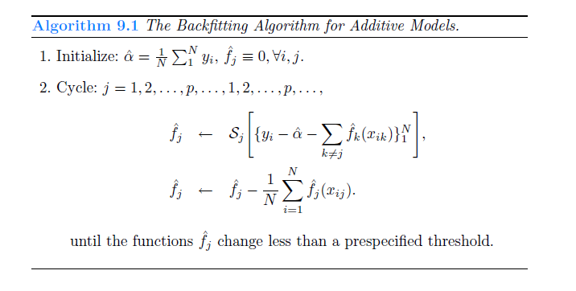
FAM(cont.)

Slide 9
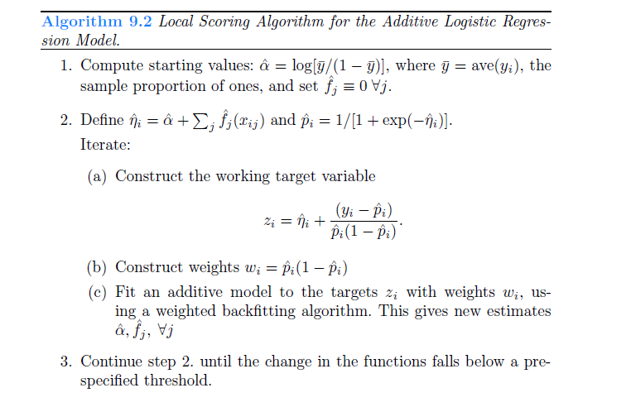
Additive Logistic Regression

Slide 10
9.2 Tree-Based Method
Background: Tree-based models partition the feature space into a set of rectangles, and then fit a simple model(like a constant) in each one.
A popular method for tree-based regression and classification is called CART(classification and regression tree)

Slide 11

CART
Example: Let’s consider a regression problem with continuous response Y and inputs X1 and X2. The top left panel of figure is one partition. To simplify matters, we consider the partition shown by the top right panel of figure. The corresponding regression model predicts Y with a constant Cm in region Rm：
For illustration, we choose C1=-5, C2=-7,C3=0,C4=2, C5=4 in the bottom right panel in figure 9.2.

Slide 12
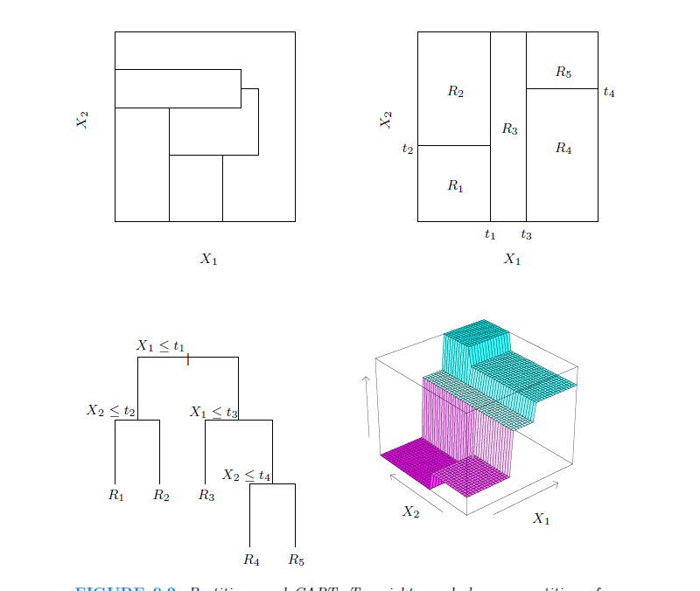
CART

Slide 13

Regression Tree
Suppose we have a partition into M regions: R1 R2 …..RM. We model the response Y with a constant Cm in each region:
If we adopt as our criterion minimization of RSS, it is easy to see that:

Slide 14

Regression Tree(cont.)
Finding the best binary partition in term of minimum RSS is computationally infeasible
A greedy algorithm is used.
Here

Slide 15
Regression Tree(cont.)
For any choice j and s, the inner minimization is solved by:
For each splitting variable Xj the determination of split point s can be done very quickly and hence by scanning through all of the input, determination of the best pair (j,s) is feasible.
Having found the best split, we partition the data into two regions and repeat the splitting progress in each of the two regions.

Slide 16
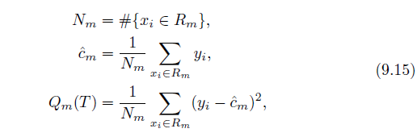

Regression Tree(cont.)
We index terminal nodes by m, with node m representing region Rm. Let |T| denotes the number of terminal notes in T. Letting:
We define the cost complexity criterion:

Slide 17




Classification Tree
: the proportion of class k on mode m.
: the majority class on node m
Instead of Qm(T) defined in(9.15) in regression, we have different measures Qm(T) of node impurity including the following:
Misclassification Error:
Gini Index:
Cross-entropy (deviance):

Slide 18
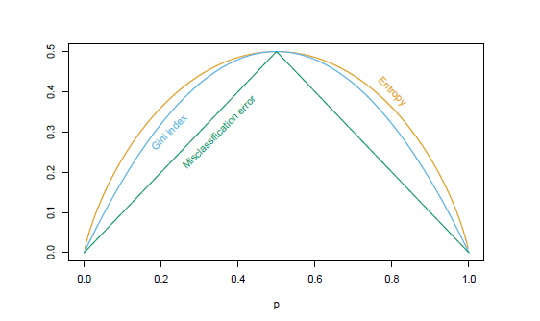
Classification Tree(cont.)
Example: For two classes, if p is the proportion of in the second class, these three measures are:
1-max(p,1-p) ,2p(1-p), -plogp-(1-p)log(1-p）

Slide 19
9.3 PRIM: Bump Hunting
The patient rule induction method(PRIM) finds boxes in the feature space and seeks boxes in which the response average is high. Hence it looks for maxima in the target function, an exercise known as bump hunting.

Slide 20
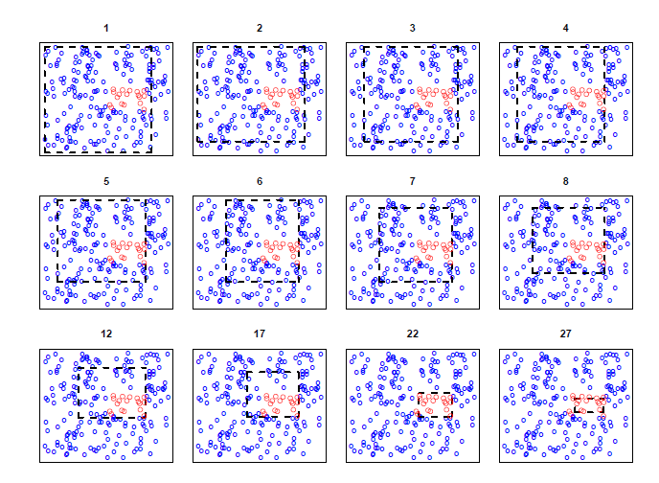
PRIM(cont.)

Slide 21
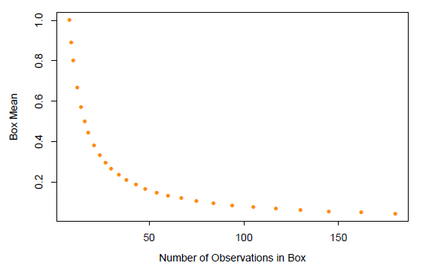
PRIM(cont.)

Slide 22
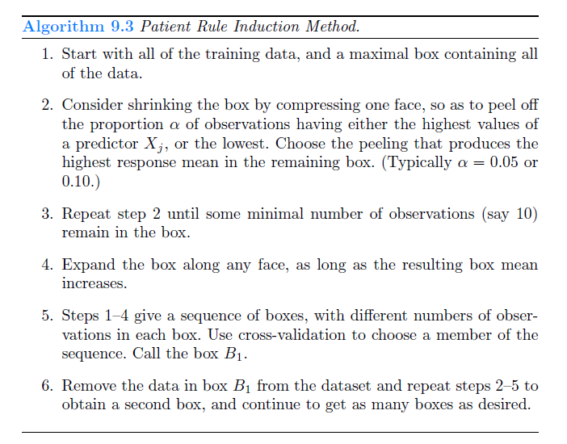
PRIM(cont.)

Slide 23
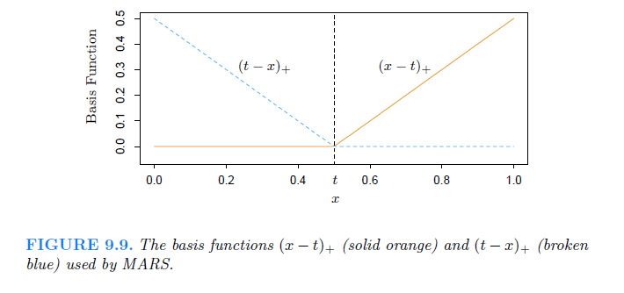
9.4 MARS: Multivariate Adaptive Regression Splines
MARS uses expansions in piecewise linear basis functions of the form: (x-t)+ and (t-x)+. We call the two functions a reflected pair.

Slide 24


MARS(cont.)
The idea of MARS is to form reflected pairs for each input Xj with knots at each observed value Xij of that input. Therefore, the collection of basis function is:
The model has the form:
where each hm(x) is a function in C or a product of two or more such functions.

Slide 25
MARS(cont.)
We start with only the constant function h0(x)=1 in the model set M and all functions in the set C are candidate functions. At each stage we add to the model set M the term of the form:
that produces the largest decrease in training error. The process is continued until the model set M contains some preset maximum number of terms.

Slide 26
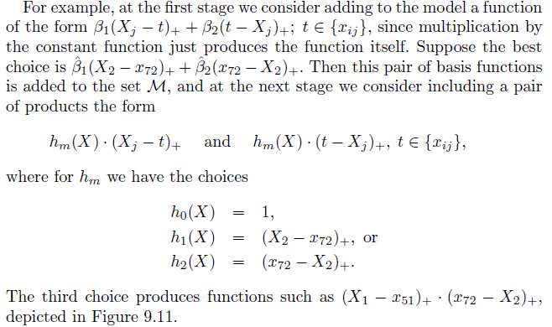
MARS(cont.)

Slide 27
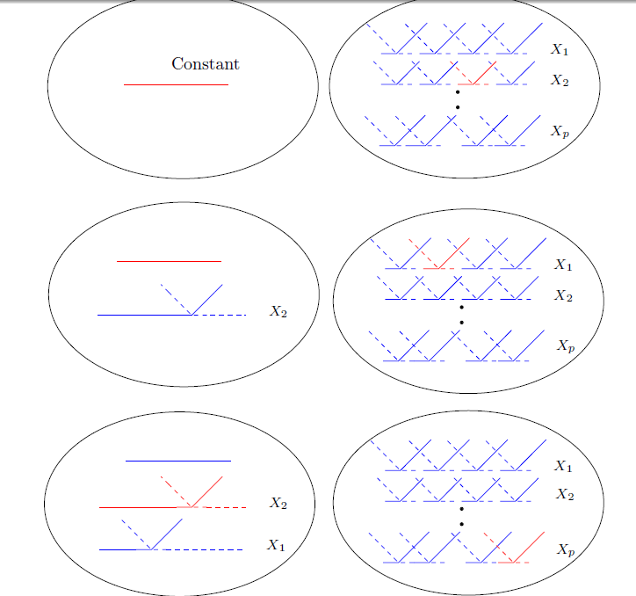
MARS(cont.)

Slide 28
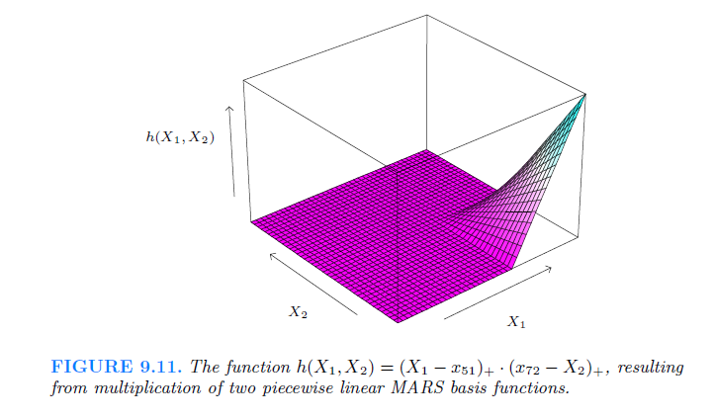
MARS(cont.)

Slide 29


MARS(cont.)
This progress typically overfits the data and so a backward deletion procedure is applied. The term whose removal causes the smallest increase in RSS is deleted from the model at each step, producing an estimated best model of each size .
Generalized cross validation is applied to estimate the optimal value of

Slide 30
9.5 Hierarchical Mixtures of Experts
The HME method can be viewed as a variant of the tree-based methods.
Difference:
The main difference is that the tree splits are not hard decisions but rather soft probabilistic ones.
In an HME a linear(or logistic regression) model is fitted in each terminal node, instead of a constant as in the CART.

Slide 31
HME(cont.)
A simple two-level HME model is shown in Figure 9.13. It can be viewed as a tree with soft splits at each non-terminal node.
The terminal node is called expert and the non-terminal node is called gating networks.
The idea is that each expert provides a prediction about the response Y, and these are combined together by the gating networks.

Slide 32
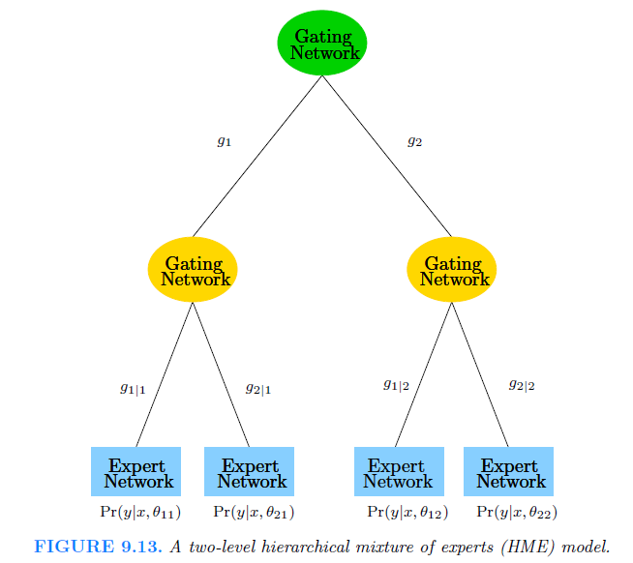
HME(cont.)

Slide 33

HME(cont.)
Here is how an HME is defined:
The top gating network has the output:
At the second level, the gating networks have a similar form:

Slide 34


HME(cont.)
At the experts, we have a model for the response variable of the form:
This differs according to the problem.

Slide 35
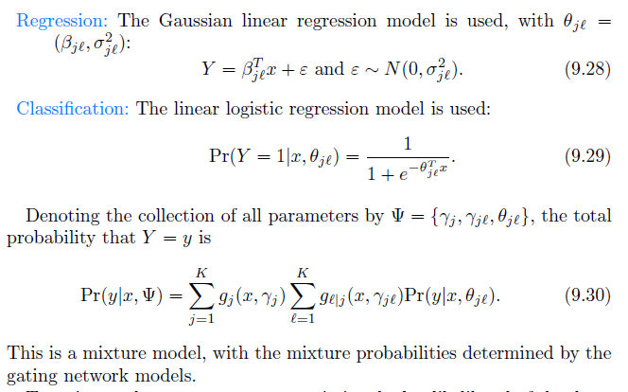
HME(cont.)

Slide 36
9.6 Missing Data
A definition:
Roughly speaking, data are missing at random if the mechanism resulting in its omission is independent of its (unobserved) value.
A more precise definition is given by Little and Rubin(2002): Suppose Y is response and X is the N*P matrix of input. Xobs denotes the observed entries in X. Z=(Y,X) and Zobs=(Y,Xobs) Finally R is an indicator matrix with ijth item 1 if Xij is missing and 0 otherwise.

Slide 37

Missing Data(cont.)
The data is said to be MAR if the distribution of R depends on Z only through Zobs:
The data is said to be MCAR if the distribution of R does not depend on Z:

Slide 38
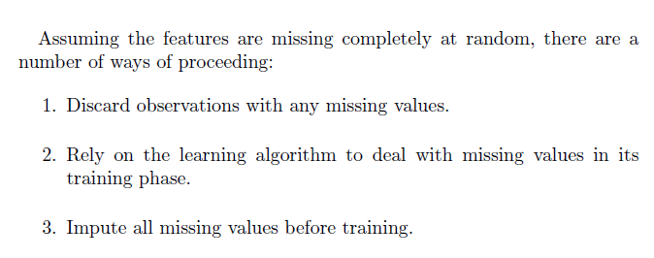
Missing Data(cont.)

Slide 39
CHAPTER 9
THE END
THANK YOU

